Slide 1
No Chip poker
Ben Rivera
CS 4283
27 April 2017

Slide 2
Project description
I created a Texas Hold ‘em variant and wrote the game in Java
TCP sockets are used for the data connection
The source is hosted on an AWS server
The server supports multithreading for multiple players
The program is accessed via client-side software

Slide 3
Game description
Welcome to this variant of Texas Hold 'em. You will begin with 50 chips. You are dealt 2 cards, and 5 cards are dealt by the dealer. Like Blackjack, you are playing against the dealer. You must post 2 chips to be dealt a hand. Checking also costs 2 chips, so fold if you think you are going to lose. If you think you may win the hand, you can bet any amount, and the dealer will always call you. If the hand goes to showdown, the winner takes all.

Slide 4
project architecture
Table()
Dealer()
Deck()
Card()
Player()
Server()
ServerThread()
ServerProtocol()
PokerClient
The user runs the PokerClient program which currently has the public DNS of the AWS server
hard-coded into it. This opens a begins a TCP 3-way handshake between the two and establishes
a stable connection. The Server() class creates a new ServerThread() for each user and uses
ServerProtocol() to manage client interaction.

Slide 5
Game architecture
Dealer()
Each poker game has a Table() that sits all of the Player() objects
Each Player() is initialized with 2 Card() objects that are drawn from a full Deck() object to ensure no duplicates
Card() extends Comparable()
A Dealer() object deals the board cards on the table and assigns hand ranks to each player
Table()
Deck()
Player()
Player()

Slide 6
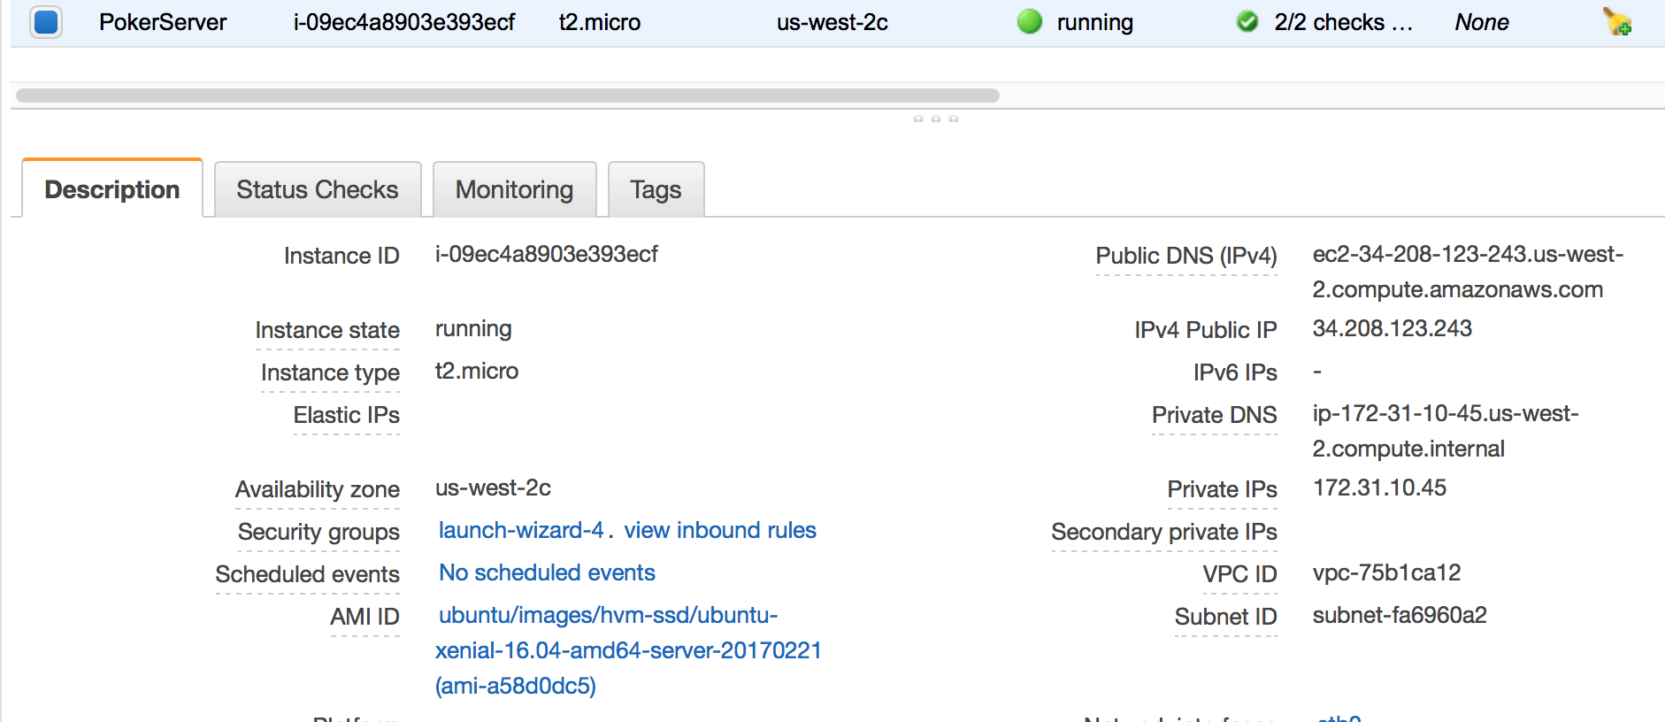
Currently running on aws
IP: 34.208.123.243

Slide 7
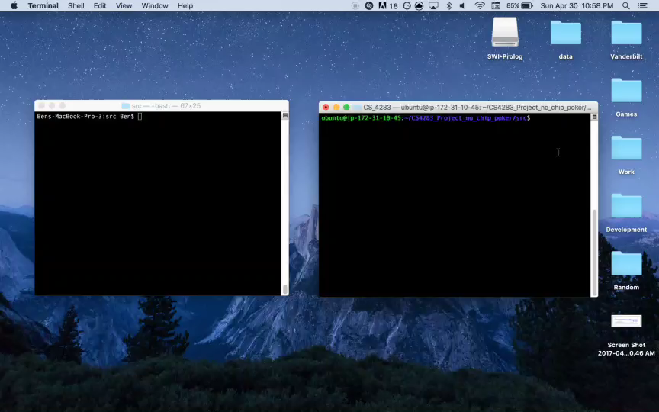
Demo

Slide 8
Challenges & solutions
Configuring the server for multithreading
I separated the server code into Server, Thread, and Protocol classes
Sending multiple lines of text from the server
I end each server message with ”END” to signal the end of a message and then hide it from the client
Assigning hand ranks
I found it difficult to assign the correct hand of 5 cards using 7 available cards. I implemented an effective algorithm after a lot of testing

Slide 9
Future goals
Add multiplayer functionality to support Player vs. Player gameplay
Transform the current variant into a real Texas Hold ‘em game with an artificially intelligent computer player
Add a graphical interface

